Slide 1
Diet Recommendation system
By – Satya Ranjan Panda (20CSE383)
Arnab Sarma (20CSE159)
Group nO. – C3

Slide 2
Abstract
Your food choices each day affect your health — how you feel today, tomorrow, and in the future. Good nutrition is an important part of leading a healthy lifestyle. Combined with physical activity, your diet can help you to reach and maintain a healthy weight, reduce your risk of chronic diseases (like heart disease and cancer), and promote your overall health. A balanced diet is one that gives your body the nutrients it needs to function correctly. The number of calories in a food is a measurement of the amount of energy stored in that food. Your body uses calories from food for walking, thinking, breathing, and other important functions. The average person needs to eat about 2,000 calories every day to maintain their weight. However, a person’s specific daily calorie intake can vary depending on their age, gender, and physical activity level. Men generally need more calories than women, and people who exercise need more calories than people who don’t.

Slide 4
Introduction
One of the major factors for a healthy life is daily diet and food, specifically, for the people suffering from some minor or major diseases. eHealth initiatives and research efforts aim to offer various pervasive applications for novice end users to improve their health. Various studies depict that inappropriate and inadequate intake of diet is the major reasons of various health issues and diseases. A study conducted by World Health Organization (WHO) estimates that around 30% of the total population of the world is suffering from various diseases, and 60% deaths each year in children are related to malnutrition. Another study by WHO reports that inadequate and imbalanced intake of food causes around 9% of heart attack deaths, about 11% of ischemic heart disease deaths, and 14% of gastrointestinal cancer deaths worldwide. Moreover, around 0.25 billion children are suffering from Vitamin-A deficiency, 0.2 billion people are suffering from iron deficiency (anaemia), and 0.7 billion people are suffering from iodine deficiency. The main focus of this work is to provide dietary assistance to different people who are suffering from common diseases or maybe no diseases. A recommender system, or a recommendation system (sometimes replacing 'system' with a synonym such as platform or engine), is a subclass of information filtering system that seeks to predict the "rating" or "preference" a user would give to an item. They are primarily used in commercial applications.

Slide 5
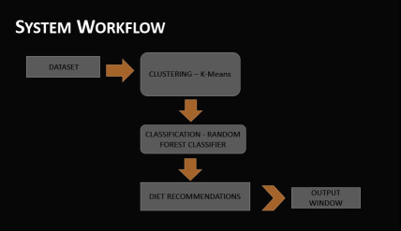

Slide 6
Problem Statements
Now-a-days due to the consumption of fast foods and other different convenient foods , people are facing many issues related to health which includes physical , mental and psychological and they’re unable to maintain their daily life .
The fast forward advanced lifestyle of people is turning out to be their worst nightmares which they want to get rid of and lead a healthy life .
Our project aims to help those people who are facing these certain issues by giving them the required diet according to their given age , height , weight , veg & non-veg preference and calculating the BMI index .

Slide 7
Hardware required Software Required
Cpu – Intel i3 (Above 8th gen)
Ram – 8 GB
Storage – >10 MB
VS Code
Jupyter
Python

Slide 8
Conclusion
This Recommendation system will help the user to get personalized diet recommendation on the basis of your BMI, age , height, overweight or underweight and help with to either to gain weight or lose weight or to follow a healthy diet.

